Slide 1
MOBILE PRICE CLASSIFICATION

Slide 2
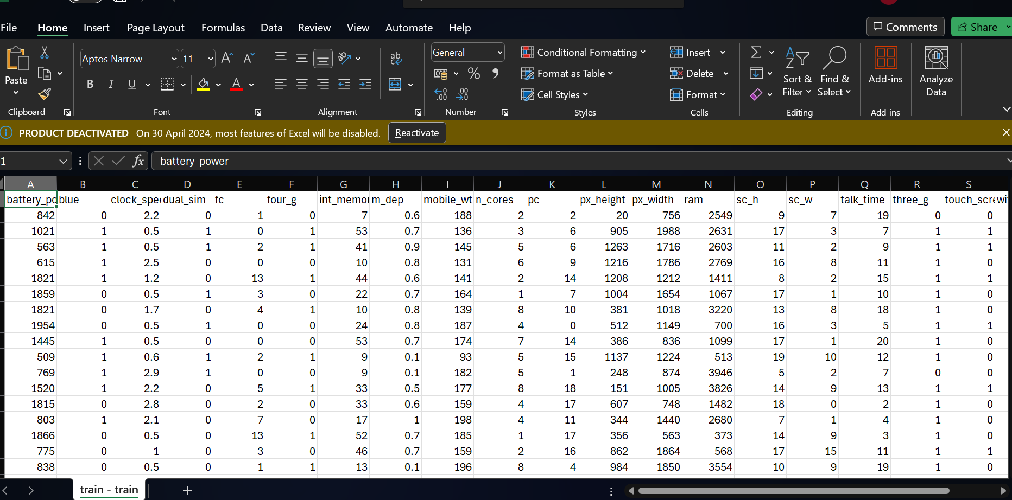
DATASET

Slide 3
These are some library used for classifying mobile price
import pandas as pd
import numpy as np
import matplotlib.pyplot as plt
import seaborn as sns
Import plotly.express as px
from sklearn.model_selection import train_test_split
from sklearn.preprocessing import StandardScaler
from sklearn.linear_model import LinearRegression
from sklearn.svm import SVR
from sklearn.tree import DecisionTreeRegressor
from sklearn.ensemble import RandomForestRegressor
from sklearn.metrics import r2_score

Slide 4
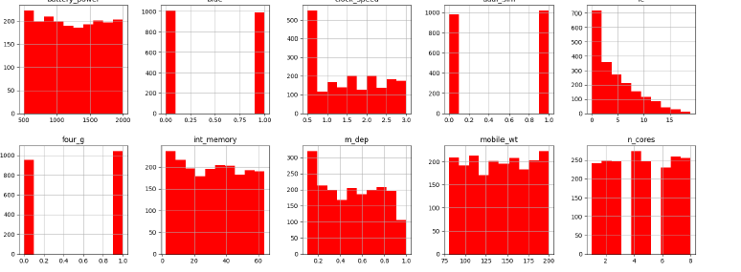
to visualize the distribution of data and gain insights into its underlying patterns in the given data we plot Hist Graph using

Slide 5
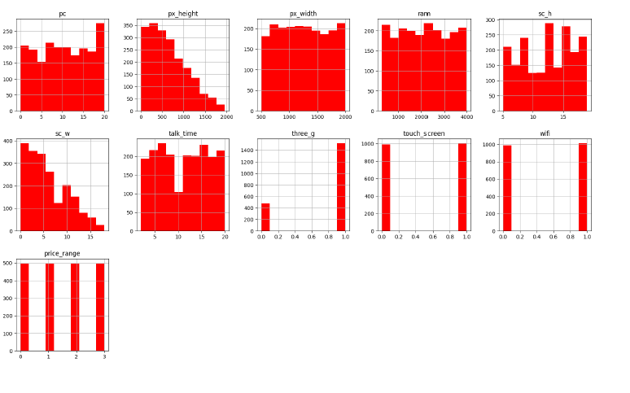

Slide 6
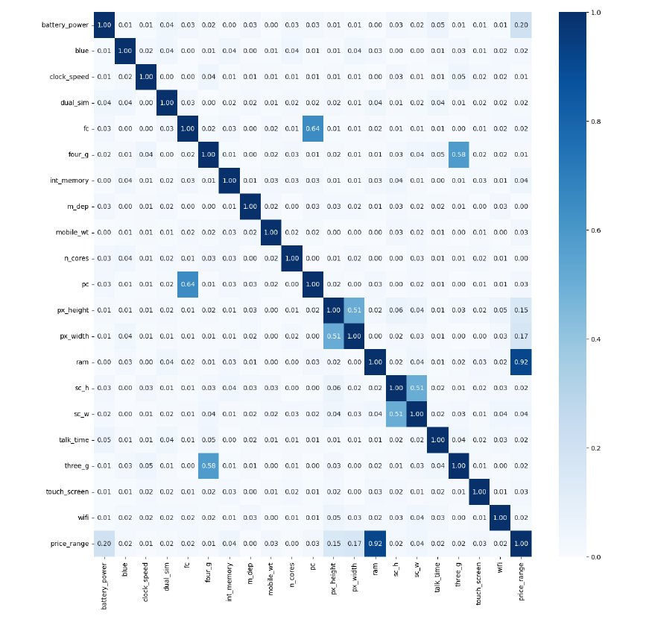
Using Heatmaps to show relationships between two or variables(columns) in the data which show correlation between data columns, one plotted on each axis.

Slide 7
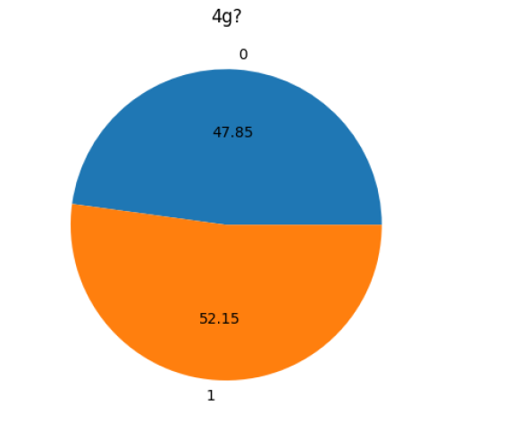
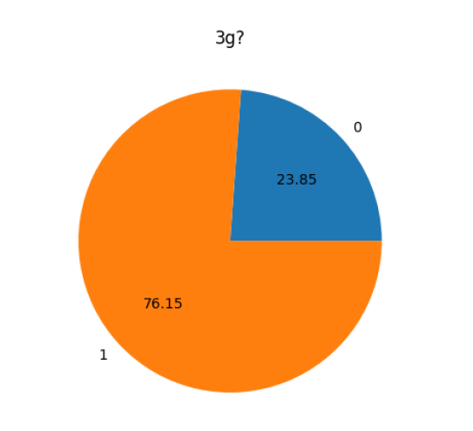
Pie Chart to show the Mobile has or not 3G or 4G feacture in it by doing Analysis:

Slide 8
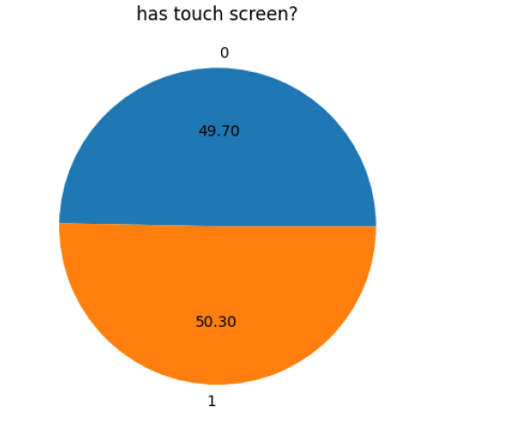
Analyzing the data the mobile has touch screen feacture in it on not
0 – No
1 - Yes

Slide 9
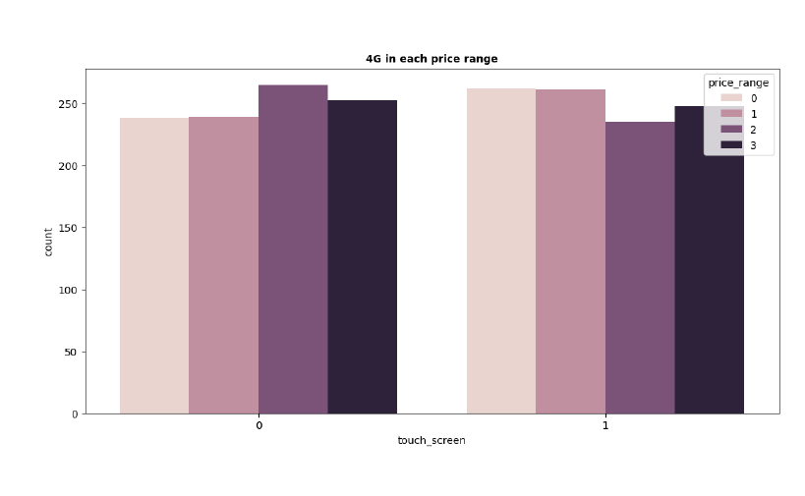
Which type of mobile comes under type type of ranges on the bases of touch screen

Slide 10
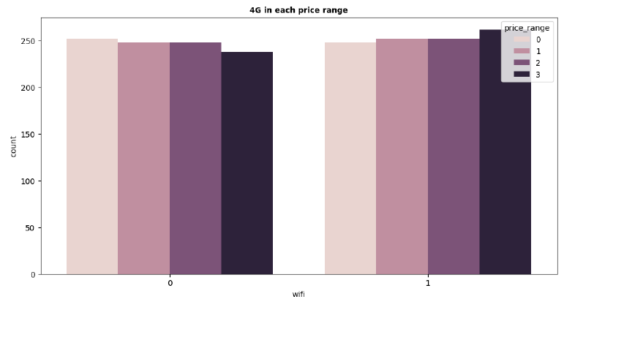
Which type of mobile comes under type type of ranges on the bases of Wifi

Slide 11
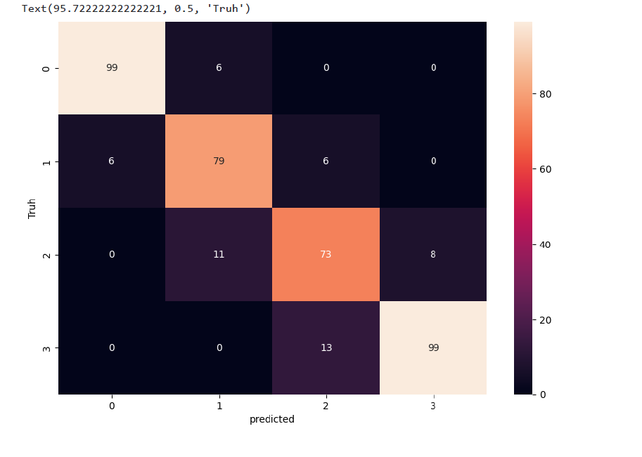
Prediction by classification on data set between
Truh and Prediction

Slide 12
Thanking You

